Slide 1
Assemblers

Slide 2
Assembler: Definition
Translating source code written in assembly language to object code.

Slide 3
Language Levels
High Level Language
Assembler Language
Machine Language
Micro -programming
Firmware
Hardware

Slide 4
Machine code
Machine code:
Set of commands directly executable via CPU
Commands in numeric code
Lowest semantic level

Slide 5
Machine code language
Structure:
Operation code
Defining executable operation
Operand address
Specification of operands
Constants/register addresses/storage addresses
OpCode
OpAddress

Slide 6
Elements of the Assembly Language Programming
An Assembly language is a
machine dependent,
low level Programming language specific to a certain computer system.
Three features when compared with machine language are
Mnemonic Operation Codes
Symbolic operands
Data declarations

Slide 7
Elements of the Assembly Language Programming
Mnemonic operation codes: eliminates the need to memorize numeric operation codes.
Symbolic operands: Symbolic names can be associated with data or instructions. Symbolic names can be used as operands in assembly statements (need not know details of memory bindings).
Data declarations: Data can be declared in a variety of notations, including the decimal notation (avoids conversion of constants into their internal representation).

Slide 8
Assembly language-structure
<Label>
<Mnemomic>
<Operand>
Comments
Label
symbolic labeling of an assembler address (command address at Machine level)
Mnemomic
Symbolic description of an operation
Operands
Contains of variables or addresse if necessary
Comments

Slide 9
Statement format
An Assembly language statement has following format:
[Label] <opcode> <operand spec>[,<operand spec>..]
If a label is specified in a statement, it is associated as a symbolic name with the memory word generated for the statement.
<operand spec> has the following syntax:
<symbolic name> [+<displacement>] [(<index register>)]
Eg. AREA, AREA+5, AREA(4), AREA+5(4)

Slide 10
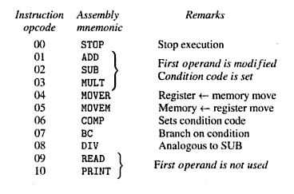
Mnemonic Operation Codes
Each statement has two operands, first operand is always a register and second operand refers to a memory word using a symbolic name and optional displacement.

Slide 11
Operation Codes
MOVE instructions move a value between a memory word and a register
MOVER – First operand is target and second operand is source
MOVEM – first operand is source, second is target
All arithmetic is performed in a register (replaces the contents of a register) and sets condition code.
A Comparision instruction sets condition code analogous to arithmetics, i.e. without affecting values of operands.
condition code can be tested by a Branch on Condition (BC) instruction and the format is:
BC <condition code spec> , <memory address>

Slide 12

Machine Instruction Format
sign is not a part of the instruction
Opcode: 2 digits, Register Operand: 1 digit, Memory Operand: 3 digits
Condition code specified in a BC statement is encoded into the first operand using the codes 1- 6 for specifications LT, LE, EQ, GT, GE and ANY respectively
In a Machine Language Program, all addresses and constants are shown in decimal as shown in the next slide

Slide 13
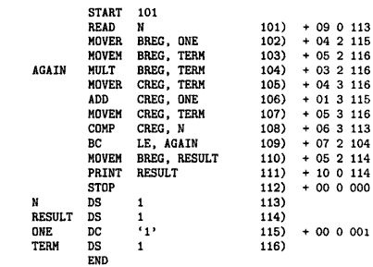
Example: ALP and its equivalent Machine Language Program

Slide 14
Assembly Language Statements
An assembly program contains three kinds of statements:
Imperative Statements
Declaration Statements
Assembler Directives
Imperative Statements: They indicate an action to be performed during the execution of an assembled program. Each imperative statement is translated into one machine instruction.

Slide 15
Assembly Language Statements
Declaration Statements: syntax is as follows:
[Label] DS <constant>
[Label] DC '<value>'
The DS (declare storage) statement reserves memory and associates names with them.
Ex:
A DS 1 ; reserves a memory area of 1 word, associating the name A to it
G DS 200 ; reserves a block of 200 words and the name G is associated with the
first word of the block (G+6 etc. to access the other words)
The DC (declare constant) statement constructs memory words containing constants.
Ex:
ONE DC '1’ ; associates name one with a memory word containing value 1

Slide 16
Assembly Language Statements
Use of Constants
The DC statement does not really implement constants
it just initializes memory words to given values.
The values are not protected by the assembler and can be changed by moving a new value into the memory word.
In the above example, the value of ONE can be changed by executing an instruction
MOVEM BREG, ONE

Slide 17
Assembly Language Statements
Use of Constants
An Assembly Program can use constants just like HLL, in two ways – as immediate operands, and as literals.
1) Immediate operands can be used in an assembly statement only if the architecture of the target machine includes the necessary features.
Ex: ADD AREG,5
This is translated into an instruction from two operands – AREG and the value '5' as an immediate operand

Slide 18
Assembly Language Statements
Use of Constants
2) A literal is an operand with the syntax = '<value>'.
It differs from a constant because its location cannot be specified in the assembly program.
Its value does not change during the execution of the program.
It differs from an immediate operand because no architectural provision is needed to support its use.
ADD AREG, =‘5’ ➔ ADD AREG, FIVE
FIVE DC ‘5’
Use of literals vs. Use of DC

Slide 19
Assembly Language Statements
Assembler Directive
Assembler directives instruct the assembler to perform certain actions during the assembly of a program.
Some assembler directives are described in the following:
1) START <constant>
This directive indicates that the first word of the target program generated by the assembler should be placed in the memory word having address <constant>.
2) END [<operand spec>]
This directive indicates the end of the of the source program. The optional <operand spec> indicates the address of the instruction where the execution of the program should begin.

Slide 20
Advantages of Assembly Language
The primary advantages of assembly language programming over machine language programming are due to the use of symbolic operand specifications.
(in comparison to machine language program)
Assembly language programming holds an edge over HLL programming in situations where it is desirable to use architectural features of a computer.
(in comparison to high level language program)

Slide 21
Fundamentals of LP
Language processing = analysis of source program + synthesis of target program
Analysis of source program is specification of the source program
Lexical rules: formation of valid lexical units(tokens) in the source language
Syntax rules : formation of valid statements in the source language
Semantic rules: associate meaning with valid statements of the language

Slide 22
Fundamentals of LP
Synthesis of target program is construction of target language statements
Memory allocation : generation of data structures in the target program
Code generation

Slide 23
A simple Assembly Scheme
There are two phases in specifying an assembler:
Analysis Phase
Synthesis Phase(the fundamental information requirements will arise in this phase)

Slide 24
A simple Assembly Scheme
Design Specification of an assembler
There are four steps involved to design the specification of an assembler:
Identify information necessary to perform a task.
Design a suitable data structure to record info.
Determine processing necessary to obtain and maintain the info.
Determine processing necessary to perform the task

Slide 25
Synthesis Phase: Example
Consider the following statement:
MOVER BREG, ONE
The following info is needed to synthesize machine instruction for this stmt:
Address of the memory word with which name ONE is associated [depends on the source program, hence made available by the Analysis phase].
Machine operation code corresponding to MOVER [does not depend on the source program but depends on the assembly language, hence synthesis phase can determine this information for itself]
Note: Based on above discussion, the two data structures required during the synthesis phase are described next

Slide 26
Data structures in synthesis phase
Symbol Table --built by the analysis phase
The two primary fields are name and address of the symbol used to specify a value.
Mnemonics Table --already present
- The two primary fields are mnemonic and opcode, along with length.
Synthesis phase uses these tables to obtain
The machine address with which a name is associated.
The machine op code corresponding to a mnemonic.
The tables have to be searched with the
Symbol name and the mnemonic as keys

Slide 27
Analysis Phase
Primary function of the Analysis phase is to build the symbol table.
It must determine the addresses with which the symbolic names used in a program are associated
It is possible to determine some addresses directly like the address of first instruction in the program (ie.,start)
Other addresses must be inferred
To determine the addresses of the symbolic names we need to fix the addresses of all program elements preceding it through Memory Allocation.
To implement memory allocation a data structure called location counter is introduced.

Slide 28
Analysis Phase – Implementing memory allocation
LC(location counter) :
is always made to contain the address of the next memory word in the target program.
It is initialized to the constant specified at the START statement.
When a LABEL is encountered,
it enters the LABEL and the contents of LC in a new entry of the symbol table.
LABEL – e.g. N, AGAIN, SUM etc
It then finds the number of memory words required by the assembly statement and updates the LC contents
To update the contents of the LC, analysis phase needs to know lengths of the different instructions
This information is available in the Mnemonics table and is extended with a field called length
We refer the processing involved in maintaining the LC as LC Processing

Slide 29
Example
START 100
MOVER BREG, N LC = 100 (1 byte)
MULT BREG, N LC = 101 (1 byte)
STOP LC = 102 (1 byte)
N DS 5 LC = 103
Symbol | Address
N | 103

Slide 30
Since there the instructions take different amount of memory, it is also stored in the mnemonic table in the “length” field
Mnemonic | Opcode | Length
MOVER | 04 | 1
MULT | 03 | 1

Slide 31
Data structures of an assembler
During analysis and
Synthesis phases
Mnemonic | Opcode | length
ADD | 01 | 1
SUB | 02 | 1
Mnemonic Table
Analysis Phase
Synthesis
Phase
Target
Program
Source
Program
--------------------------------->
Symbol | Address
N | 104
AGAIN | 113
Data Access
-- > Control Access
Symbol Table

Slide 32
Data structures
Mnemonics table is a fixed table which is merely accessed by the analysis and synthesis phases
Symbol table is constructed during analysis and used during synthesis

Slide 33
Tasks Performed : Analysis Phase
Isolate the labels, mnemonic, opcode and operand fields of a statement.
If a label is present, enter (symbol, <LC>) into the symbol table.
Check validity of the mnemonic opcode using mnemonics table.
Update value of LC.

Slide 34
Tasks Performed : Synthesis Phase
Obtain machine opcode corresponding to the mnemonic from the mnemonic table.
obtain address of the memory operand from symbol table.
Synthesize a machine instruction or machine form of a constant, depending on the instruction.

Slide 35
Assembler’s functions
Convert mnemonic operation codes to their machine language equivalents
Convert symbolic operands to their equivalent machine addresses
Build the machine instructions in the proper format
Convert the data constants to internal machine representations
Write the object program and the assembly listing

Slide 36
Assembler:Design
The design of assembler can be of:
Scanning (tokenizing)
Parsing (validating the instructions)
Creating the symbol table
Resolving the forward references
Converting into the machine language

Slide 37
Assembler Design
Pass of a language processor – one complete scan of the source program
Assembler Design can be done in:
Single pass
Two pass
Single Pass Assembler:
Does everything in single pass
Cannot resolve the forward referencing
Two pass assembler:
Does the work in two pass
Resolves the forward references

Slide 38
Difficulties: Forward Reference
Forward reference: reference to a label that is defined later in the program.
Problem of forward reference in single pass assembler is resolved by backpaching.
START 100
MOVER BREG, N
MULT BREG, N
STOP
N DS 5

Slide 39
Backpatching
The problem of forward references is handled using a process called backpatching
Initially, the operand field of an instruction containing a forward reference is left blank
Ex: MOVER BREG, ONE can be only partially synthesized since ONE is a forward reference
The instruction opcode and address of BREG will be assembled to reside in location 101
To insert the second operand’s address later, an entry is added in Table of Incomplete Instructions (TII)
The entry TII is a pair (<instruction address>, <symbol>) which is (101, ONE) here

Slide 40
Backpatching
The problem of forward references is handled using a process called backpatching
When END statement is processed, the symbol table would contain the addresses of all symbols defined in the source program
So TII would contain information of all forward references
Now each entry in TII is processed to complete the instruction
Ex: the entry (101, ONE) would be processed by obtaining the address of ONE from symbol table and inserting it in the operand field of the instruction with assembled address 101.
Alternatively, when definition of some symbol L is encountered, all forward references to L can be processed

Slide 41
Assembler Design
First pass:
Scan the code by separating the symbol, mnemonic op code and operand fields
Perform LC processing
Record symbol and its address (LC) in to symbol table
Construct intermediate representation
Second Pass:
Converts the code to the machine code

Slide 42
Assembler Directives
Assembler directives are pseudo instructions.
They provide instructions to the assemblers itself.
They are not translated into machine operation codes.like START , END.
Advanced Assembler directives are
ORIGIN <address specification>
Where <address specification> is <operand specification> or <constatnt> , this directive instruct the assembler to put <address specification> to location counter. Useful when lack of single contiguous area of memory.

Slide 43
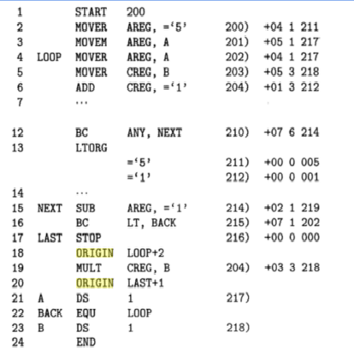



Slide 44
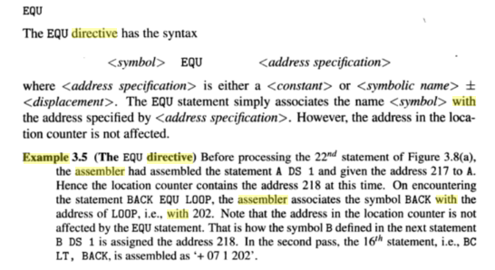
EQU

Slide 45
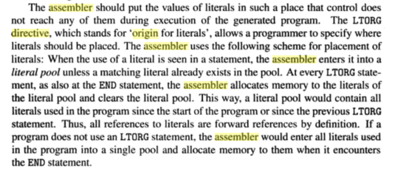
LTORG

Slide 46
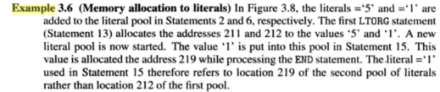

Slide 47
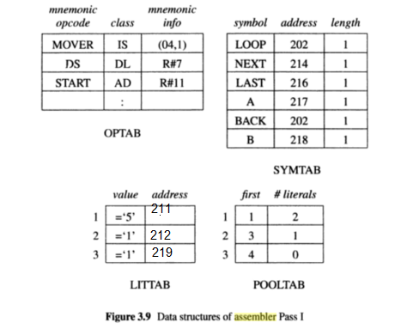
Two Pass Assembler
Source
program
Intermediate
file
Pass 1
Pass 2
Object
codes
OPTAB
SYMTAB
SYMTAB
LITTABLE
POOLTABLE

Slide 48
Data Structures in Pass I
OPTAB – a table of mnemonic op codes
Contains mnemonic op code, class and mnemonic info
Class field indicates whether the op code corresponds to
an imperative statement (IS),
a declaration statement (DL) or
an assembler Directive (AD)
For IS, mnemonic info field contains the pair ( machine opcode, instruction length)
Else, it contains the id of the routine to handle the declaration or a directive statement
The routine processes the operand field of the statement to determine the amount of memory required and updates LC and the SYMTAB entry of the symbol defined

Slide 49
Data Structures in Pass I
SYMTAB - Symbol Table
Contains address and length
LOCCTR - Location Counter
LITTAB – a table of literals used in the program
Contains literal and address
Literals are allocated addresses starting with the current value in LC and LC is incremented, appropriately

Slide 50
OPTAB (operation code table)
Content
Menmonic opcode, class and mnemonic info
Characteristic
static table
Implementation
array or hash table, easy for search

Slide 51
SYMTAB (symbol table)
Content
label name, value, flag, (type, length) etc.
Characteristic
dynamic table (insert, delete, search)
Implementation
hash table, non-random keys, hashing function

Slide 52
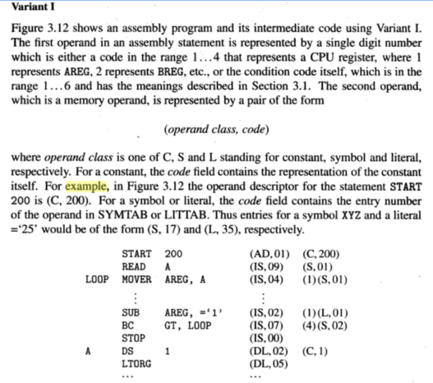
IC

Slide 53
